Slide 1
Computer Networks
Khizar Mukhtiar
Department of Computer Science
National University of Computer & Emerging Sciences

Slide 2
Recap
Go-Back-N

Slide 3
Go-Back-N in action
Consider the Go-Back-N (GBN) protocol operating over a link with a sender window size of N = 4. Transmission delay for a data packet is 1ms, one-way propagation delay is 4ms, ACK packet transmission delay is negligible (0ms), and the timeout interval for any unacknowledged packet is 15ms (measured from the end of packet transmission). Transmission begins at t = 0ms with data packets numbered 0, 1, 2, 3, 4, 5. During the initial transit, pkt2 is lost on the forward link, while all other packets and ACKs arrive safely.
State the exact timestamps t at which the sender transmits pkt0 through pkt5
For each packet arriving at the receiver up to t = 25ms, specify whether the receiver accepts or discards it, and state the ACK number returned.
Specify the state of the sender's window right before the timer for pkt2 expires.
Calculate the protocol's link utilization under error-free conditions

Slide 4
Selective repeat
Receiver individually acknowledges all correctly received packets
  buffers packets, as needed, for eventual in-order delivery to upper layer
Sender times-out/retransmits individually for unACKed packets
  sender maintains timer for each unACKed pkt
Sender window
  N consecutive seq #s
  limits seq #s of sent, unACKed packets

Slide 5
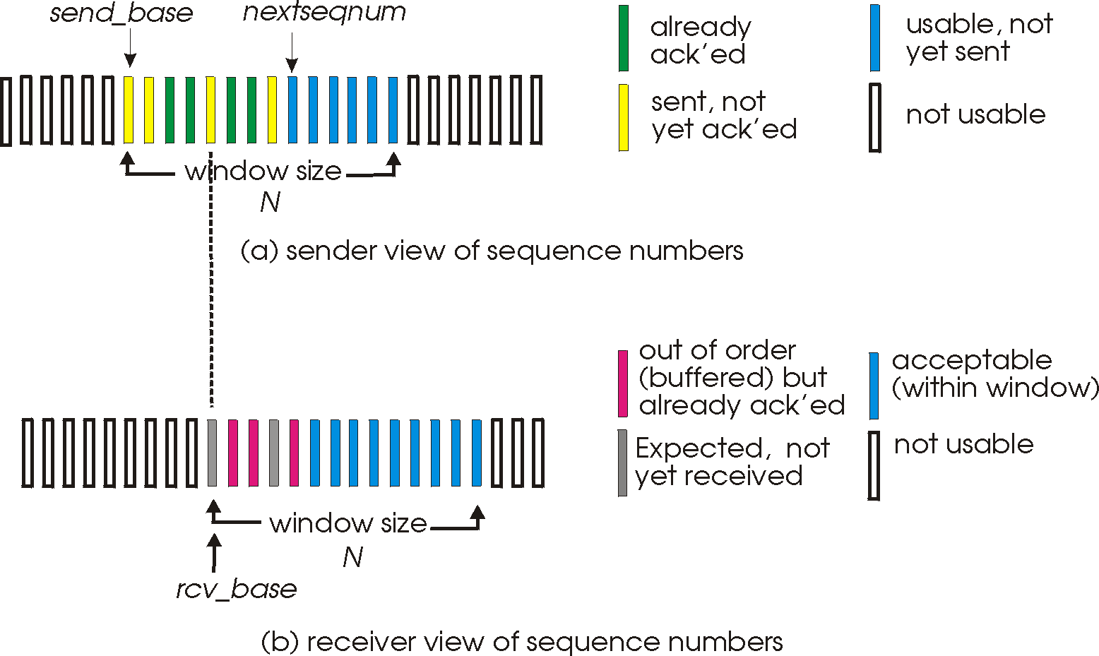
Selective repeat: sender, receiver windows

Slide 6
Selective repeat: sender and receiver
sender
receiver
data from above:
if next available seq # in window, send packet
timeout(n):
resend packet n, restart timer
ACK(n) in [sendbase,sendbase+N]:
mark packet n as received
if n smallest unACKed packet, advance window base to next unACKed seq #
packet n in [rcvbase, rcvbase+N-1]
send ACK(n)
out-of-order: buffer
in-order: deliver (also deliver buffered, in-order packets), advance window to next not-yet-received packet
packet n in [rcvbase-N,rcvbase-1]
ACK(n). But why ¯\_(ツ)_/¯ ?
otherwise:
ignore

Slide 7

Selective Repeat in action
sender window (N=4)
sender
receiver
0 1 2 3 4 5 6 7 8
send pkt0
send pkt1
send pkt2
send pkt3
(wait)
0 1 2 3 4 5 6 7 8
receive pkt0, send ack0
receive pkt1, send ack1
receive pkt3, buffer,
send ack3
0 1 2 3 4 5 6 7 8
X
0 1 2 3 4 5 6 7 8
loss
0 1 2 3 4 5 6 7 8
rcv ack0, send pkt4
0 1 2 3 4 5 6 7 8
rcv ack1, send pkt5
receive pkt4, buffer,
send ack4
record ack3 arrived
receive pkt5, buffer,
send ack5
pkt 2 timeout
0 1 2 3 4 5 6 7 8
send pkt2
(but not 3,4,5)
0 1 2 3 4 5 6 7 8
0 1 2 3 4 5 6 7 8
rcv pkt2; deliver pkt2,
pkt3, pkt4, pkt5; send ack2
0 1 2 3 4 5 6 7 8
Q: what happens when ack2 arrives?

Slide 8
https://www.tkn.tu-berlin.de/teaching/rn/animations/gbn_sr/

Slide 9
In-class Assignment

